Slide 1
Circular Linked List
Data Structures
And
Algorithms

Slide 2
Circular Linked Lists
In linear linked lists if a list is traversed (all the elements visited) an external pointer to the list must be preserved in order to be able to reference the list again.
Circular linked lists can be used to help the traverse the same list again and again if needed. A circular list is very similar to the linear list where in the circular list the pointer of the last node points not NULL but the first node.

Slide 3

Circular Linked Lists
A Linear Linked List

Slide 4
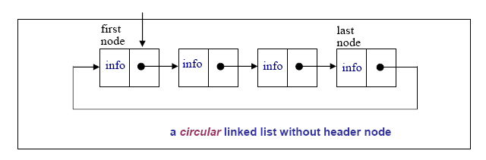
Circular Linked Lists

Slide 5
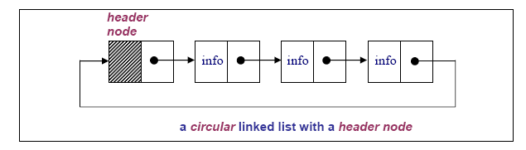
Circular Linked Lists

Slide 6
Circular Linked Lists
In a circular linked list there are two methods to know if a node is the first node or not.
Either a external pointer, list, points the first node or
A header node is placed as the first node of the circular list.
The header node can be separated from the others by either heaving a sentinel value as the info part or having a dedicated flag variable to specify if the node is a header node or not.

Slide 7
PRIMITIVE FUNCTIONS IN CIRCULAR LISTS
The structure definition of the circular linked lists and the linear linked list is the same:
struct node{
int info;
struct node *next;
};
typedef struct node *NODEPTR;

Slide 8
PRIMITIVE FUNCTIONS IN CIRCULAR LISTS
The delete after and insert after functions of the linear lists and the circular lists are almost the same.
The delete after function: delafter( )
void delafter(NODEPTR p, int *px)
{
NODEPTR q;
if((p == NULL) || (p == p->next)){ /*the empty list
contains a single node and may be pointing itself*/
printf(“void deletion\n”);
exit(1);
}
q = p->next;
*px = q->info; /*the data of the deleted node*/
p->next = q->next;
freenode(q);
}

Slide 9
PRIMITIVE FUNCTIONS IN CIRCULAR LISTS
The insertafter function: insafter( )
void insafter(NODEPTR p, int x)
{
NODEPTR q;
if(p == NULL){
printf(“void insertion\n”);
exit(1);
}
q = getnode();
q->info = x; /*the data of the inserted node*/
q->next = p->next;
p->next = q;
}

Slide 10
CIRCULAR LIST with header node
The header node in a circular list can be specified by a sentinel value or a dedicated flag:
Header Node with Sentinel: Assume that info part contains positive integers. Therefore the info part of a header node can be -1. The following circular list is an example for a sentinel used to represent the header node:
struct node{
int info;
struct node *next;
};
typedef struct node *NODEPTR;

Slide 11
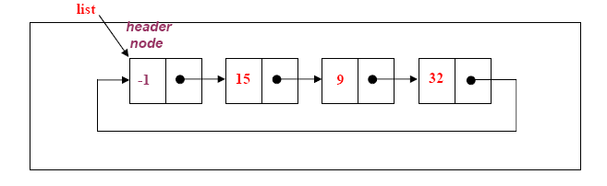
CIRCULAR LIST with header node

Slide 12
CIRCULAR LIST with header node
Header Node with Flag: In this case a extra variable called flag can be used to represent the header node. For example flag in the header node can be 1, where the flag is 0 for the other nodes.
struct node{
int flag;
int info;
struct node *next;
};
typedef struct node *NODEPTR;

Slide 13
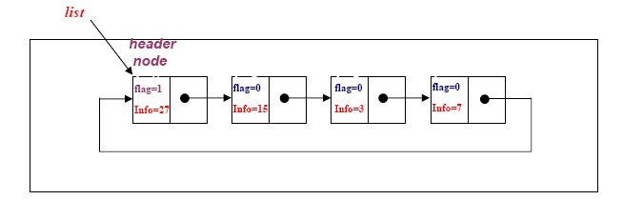
CIRCULAR LIST with header node

Slide 14
Example
Consider a circular linked list with a header node, where each node contains the name, account number and the balance of a bank customer. The header node contains a sentinel account number to be -99.
(a) Write an appropriate node structure definition for the circular linked list.
(b) Write a function to display the full records of the customers with negative balance.

Slide 15
a) struct node{
char Name[15]; int AccNo;
float Balance;
struct node *next;
};
typedef struct node *NODEPTR;
b) Assume that the list pointer points the header with the sentinel account number -99.
void DispNegBalanca(NODEPTR *plist)
{
NODEPTR p;
p=*plist;
if(p == NULL){
printf(“There is no list!\n”);
exit(1);
}
p=p->next;
while(p->AccNo!=-99){
if(p->Balance < 0.0)
printf(“The Customer Name:%s\nThe Account No:%d\nThe
Balance:%.2f\n”, p->Name, p->AccNo, p->Balance);
p=p->next;
}
}

Slide 16
Example
Write a function that returns the average of the numbers in a circular list. Assume that the following node structure is used, where the flag variable is 1 for the header node and 0 for all the other nodes.
struct node{
int flag;
float info;
struct node *next;
};
typedef struct node *NODEPTR;

Slide 17
float avList(NODEPTR *plist)/*assume that plist points the header node*/
{
int count=0;
float sum =0.0;
NODEPTR p;
p=*plist;
if((p == NULL)){
printf(“Empty list\n”);
exit(1);
}
do{
sum=sum + p->info;
p =p->next;
count++;
}while(p->flag !=1);
return sum/count;
}

